Slide 1
PROBABILITY AND STATISTICS
Bayes’ Theorem

Slide 2
Example:
Consider a fictitious computer company. We might ask the following questions:
  What is the probability that consumers will actually buy a new computer?
  What is the probability that consumers are planning to buy a new computer?
  What is the probability that consumers are planning to buy and actually will buy a new computer?
  Given that a consumer is planning to buy, what is the probability of a purchase?

Slide 3
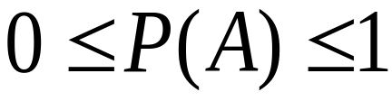
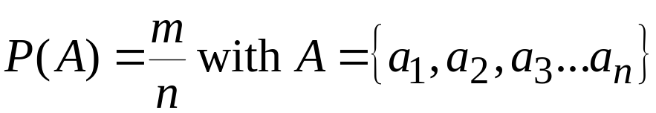
Probability Review
All probabilities fall between 0 and 1:
Probability of any event A is:
  Where m is the number of events A and n is the number of possible events

Slide 4

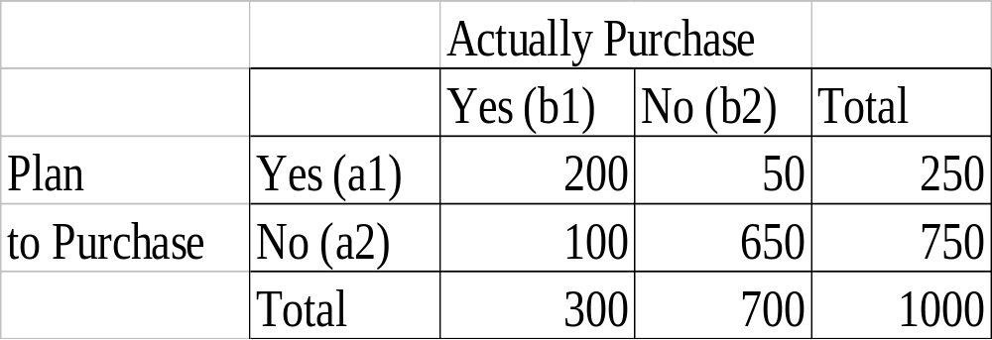
Example
The cumulative frequency is:
The sample space (of a 1000 obs) looks like this:

Slide 5


Probability Review
If we have an event A there will be a compliment to A called A’ or B
Marginal probabilities
  Event A consists of two outcomes, a₁ and a₂:
  The compliment B consists also of two outcomes, b₁ and b₂:
  two events are mutually exclusive/disjoint if both events cannot occur
  A set of events is collectively exhaustive if one of the events must occur

Slide 6
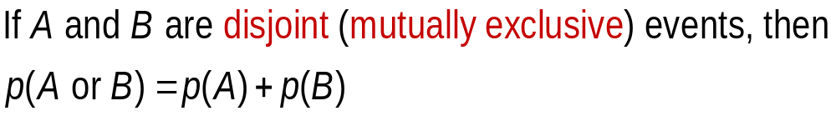
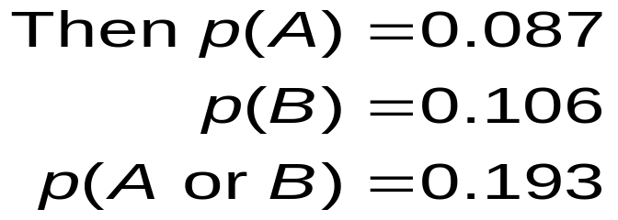
Disjoint
Example:
Let A: respondent lives in KL
Let B: respondents lives in Penang

Slide 7
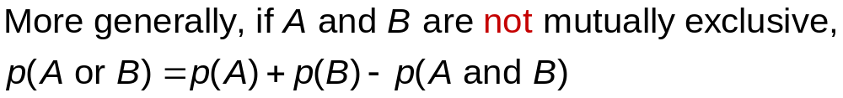



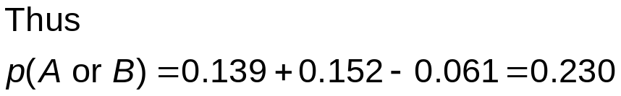
Probability of Combined Events

Slide 8

Exhaustive Events
Two or more events are said to be exhaustive if at least one of them must occur.
For example, if A is the event that the respondent sleeps less than 6 hours per night and B is the event that the respondent sleeps at least 6 hours per night, then A and B are exhaustive.

Slide 9
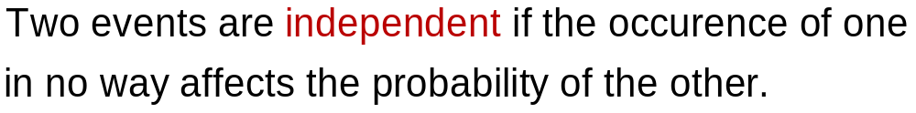
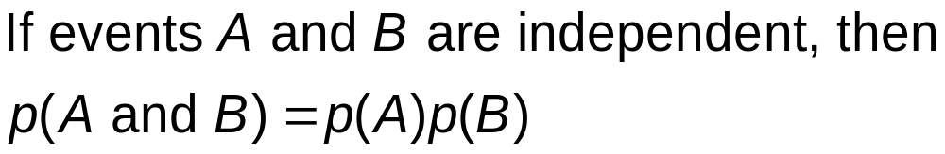
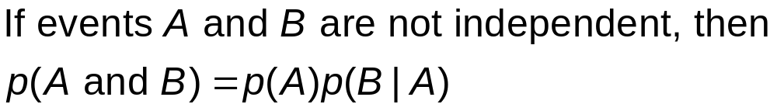
Independence

Slide 10
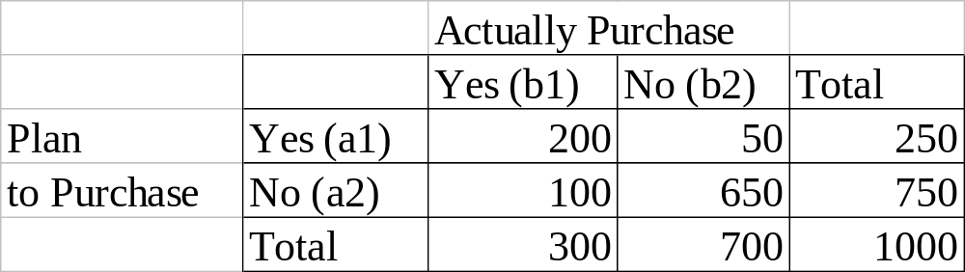
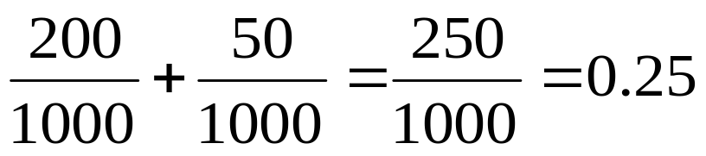
Example
If A = planned to purchase and B=actually purchased:
  P(planned to buy) = P(planned & did) + P(planned & did not)=

Slide 11
Probability Review
Example, there are 40 female students in a class of 100. 10 of them are from some foreign countries. 20 male students are also foreign students.
  A: student from a foreign country
  B: a female student

Slide 12
Venn Diagrams
30+10 = 40
20+10 = 30
Foreign
Student
(20)
Female
(30)
(10)
Male non-foreign student
(40)
Female foreign student (10)

Slide 13


Probability Review
Complement
Non Female
Female
Non Foreign
Student
Foreign
student

Slide 14
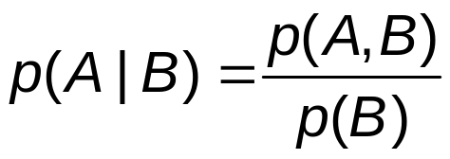
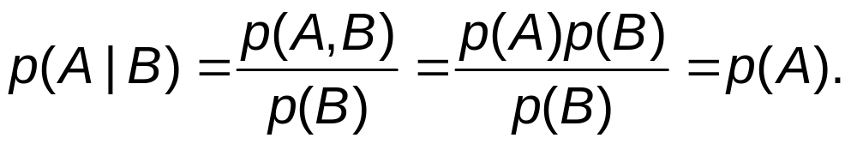

Conditional probability
The conditional probability of A given B is the joint probability of A and B, divided by the marginal probability of B.
Thus if A and B are statistically independent,
However, if A and B are statistically dependent, then

Slide 15
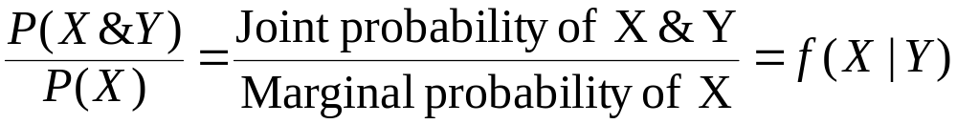
Conditional Probabilities
Conditional probabilities can be written as
  This is read as “The probability of X given Y”
  For example: The probability that someone earns between $200 and $300, given that he/she has completed 10 years of education

Slide 16
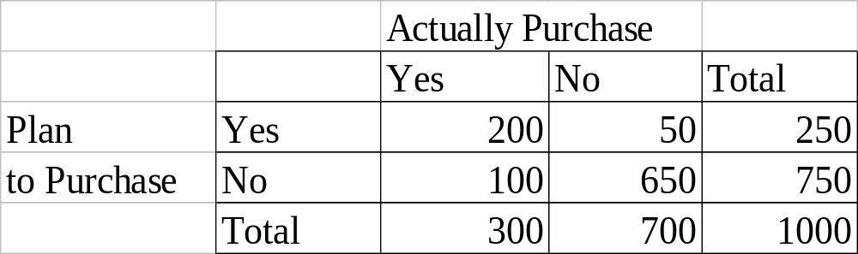
Marketing Example
Let’s look at the probability you purchased a computer given that you planned to purchase:

Slide 17
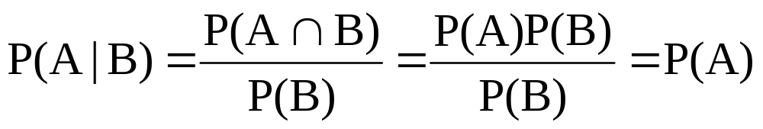
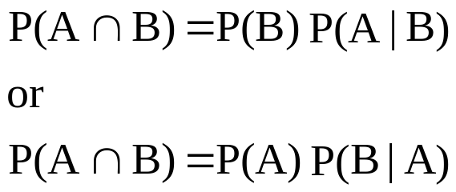
Useful Properties of Conditional Probabilities
Property 1. The Conditional Probability for Independent Events
If A and B are independent events, then:
Property 2. The Multiplication Rule for Conditional Probabilities
  In an experiment involving two non-independent events A and B, the probability that both A and B occurs can be found in the following two ways:

Slide 18
Conditional probability
P(A|B) = P(A and B) / P(B)
- Probability of A given B

Slide 19
Bayes Theorem/Rule
Someone is shooting at a target. If it is windy, he has a 40% chance hitting the target. If there is no wind, his chance is 70%.
A. If there is a 12% chance of being windy, what is his chance of hitting the target?
B. If he hits the target, what is the chance of it being windy??? → Bayes Theorem

Slide 20
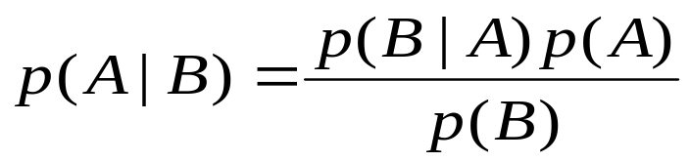
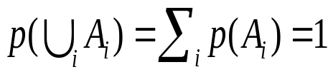

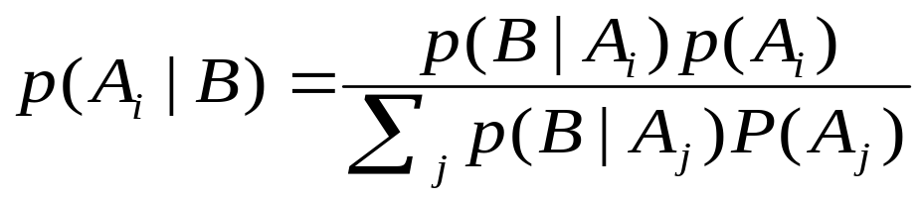
Bayes Theorem
Introduced by Reverand Thomas Bayes (1702-1761)
Bayes Theorem for probability events A and B
Or for a set of mutually exclusive and exhaustive events (i.e. ), then

Slide 21
Bayes Theorem
Think of the Bayes Theorem as probability in reverse
  You can update your probabilities in light of new information
Suppose you have a product with a known probability of success
P(success) = P(S) = 0.4
P(failure) = P(S’) = 0.6
We also know that a consumer group will write either a favorable or unfavorable report on the product
P(F|S) = 0.8 P(F|S’) = 0.3

Slide 22
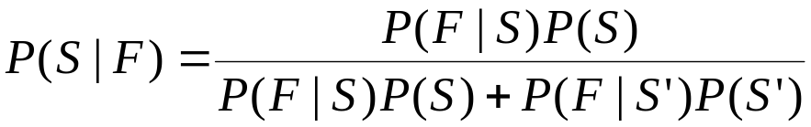
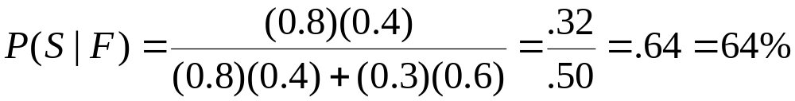
Bayes Theorem
We want to find the probability that the product will be successful given a favorable report
P(S|F)
In this case, Bayes says
We can plug values into the above equation to find
We can use the theorem to update the probability of a successful product given that the product gets a favorable report

Slide 23
Bayes Theorem/Rule
Bayes theorem deals with sequential events, whereby new
additional information is obtained for a subsequent event, and that new information is used to revise the probability of the initial event.
Prior probability - is an initial probability value originally obtained before any additional information is obtained.
Posterior probability - is a probability value that has been revised by using additional information that is later obtained.

Slide 24
Bayes Theorem/Rule - example
The Gallup organization randomly selects an adult American for a survey about credit card usage. Use subjective probabilities to estimate the following.
What is the probability that the selected subject is a male?
b. After selecting a subject, it is later learned that this person was smoking a cigar during the interview. What is the probability that the selected subject is a male?
c. Which of the preceding two results is a prior probability? Which is a posterior probability?

Slide 25
Bayes Theorem/Rule - example
Roughly half of all Americans are males, so we estimate the probability of
selecting a male subject to be 0.5. Denoting a male by M, we can express this probability as follows: P(M) = 0.5.
b. Although some women smoke cigars, the vast majority of cigar smokers are males. A reasonable guess is that 85% of cigar smokers are males. Based on this additional subsequent information that the survey respondent was smoking a cigar, we estimate the probability of this person being a male as 0.85. Denoting a male by M and denoting a cigar smoker by C, we can express this result as follows: P(M | C) = 0.85.
c. In part (a), the value of 0.5 is the initial probability, so we refer to it as the prior probability. Because the probability of 0.85 in part (b) is a revised probability based on the additional information that the survey subject was smoking a cigar, this value of 0.85 is referred to a posterior probability.

Slide 26
Bayes’ Theorem
In Orange County, 51% of the adults are males. One adult is randomly selected for a survey involving credit card usage.
Find the prior probability that the selected person is a male.
b. It is later learned that the selected survey subject was smoking a cigar. Also, 9.5% of males smoke cigars, whereas 1.7% of females smoke cigars.
Use this additional information to find the probability that the selected subject is a male.

Slide 27
Bayes’ Theorem
Let's use the following notation:
M = male M’ = female (or not male)
C = cigar smoker C’= not a cigar smoker.
Before using the information given in part b, we know only that 51% of the adults in Orange County are males, so the probability of randomly selecting an adult and getting a male is given by P(M) = 0.51.
b. Based on the additional given information, we have the following:
P(M) = 0.51 because 51% of the adults are males
P(M’) = 0.49 because 49% of the adults are females (not males)
P(C|M) = 0.095 because 9.5% of the males smoke cigars (The probability of getting someone who smokes cigars, given that the person is a male, is 0.095.)
P(C|M’) = 0.017. because 1.7% of the females smoke cigars (The probability of getting someone who smokes cigars, given that the person is a female, is 0.017.)

Slide 28
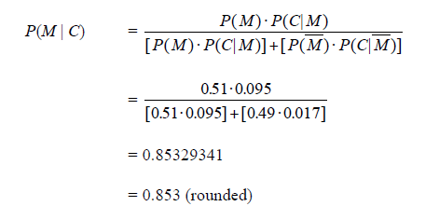
Bayes’ Theorem
Initially we knew that the survey subject smoked a cigar, there is a 0.51 probability that the survey subject is male, however, after learning that the subject smoked a cigar, we revised the probability to 0.853. This makes sense, because the likelihood of a male increases dramatically with the additional information that the subject smokes cigars (because so many more males smoke cigars than females).

Slide 29
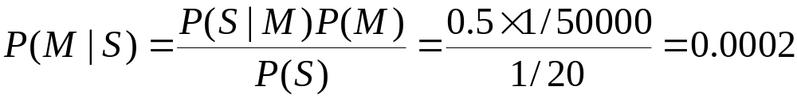
More Examples
Given:
  A doctor knows that meningitis (M) causes stiff neck (S) 50% of the time
  Prior probability of any patient having meningitis is 1/50,000
  Prior probability of any patient having stiff neck is 1/20
If a patient has stiff neck, what’s the probability he/she has meningitis?

Slide 30
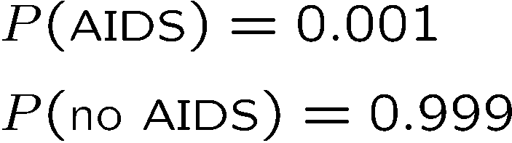
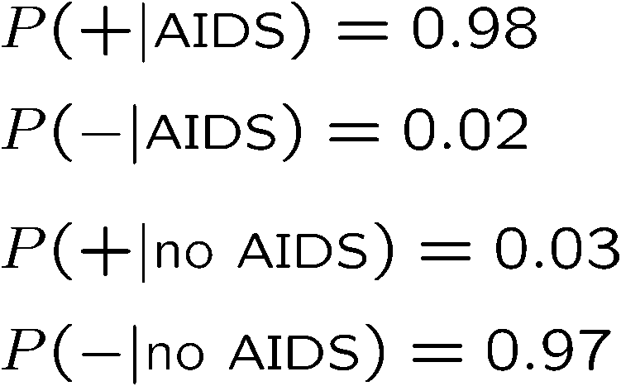
An example using Bayes’ theorem
Suppose the probability (for anyone) to have AIDS is:
← prior probabilities, i.e.,
before any test carried out
Consider an AIDS test: result is + or −
← probabilities to (in)correctly
identify an infected person
← probabilities to (in)correctly
identify an uninfected person
Suppose your result is +. How worried should you be?

Slide 31

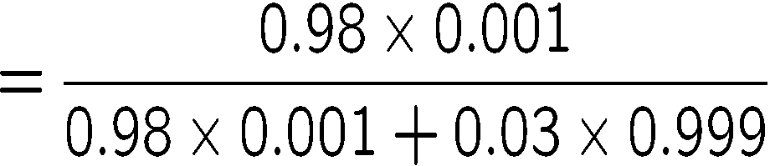

Bayes’ theorem example (cont.)
The probability to have AIDS given a + result is
← posterior probability
Your viewpoint: my degree of belief that I have AIDS is 3.2%
Your doctor’s viewpoint: 3.2% of people like this will have AIDS

Slide 32
The End

